Slide 1
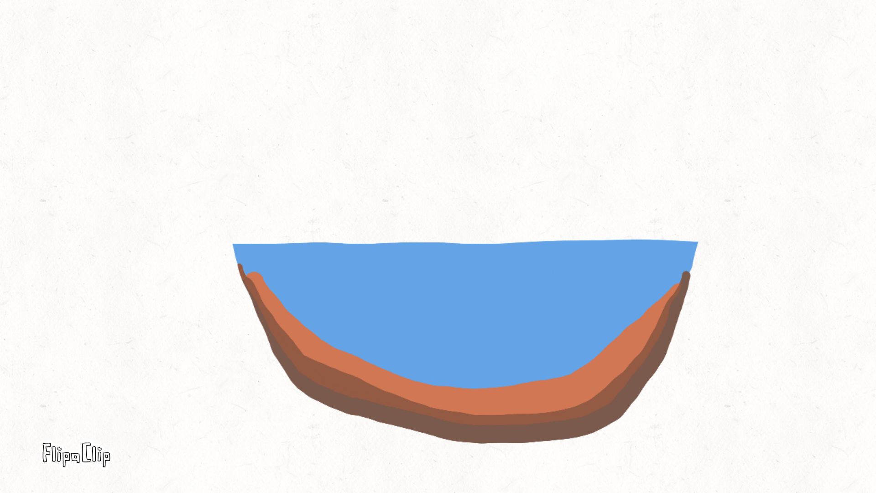

What is Lake Coring?

Slide 2
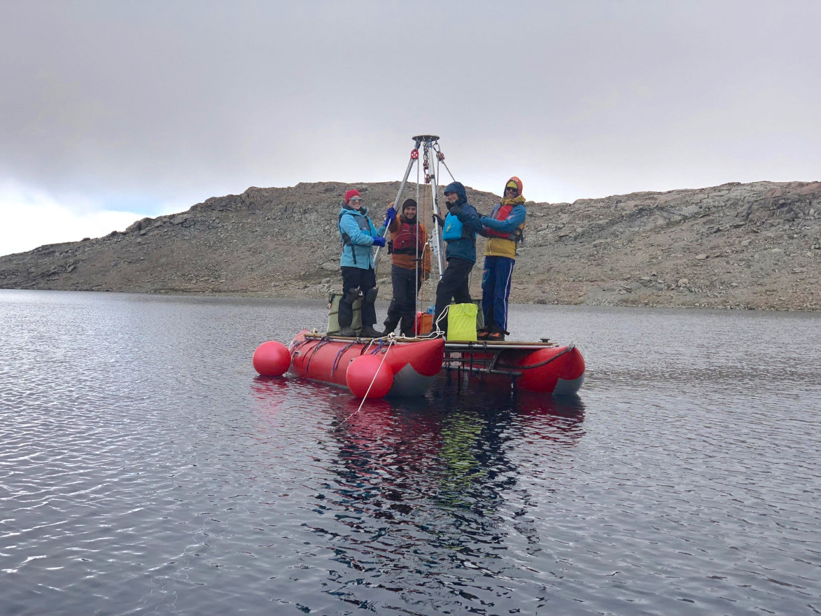
Lake Coring
Lake coring is like taking a long, skinny “time‑capsule straw” out of the bottom of a lake so scientists can learn what the lake was like hundreds or even thousands of years ago.

Slide 3
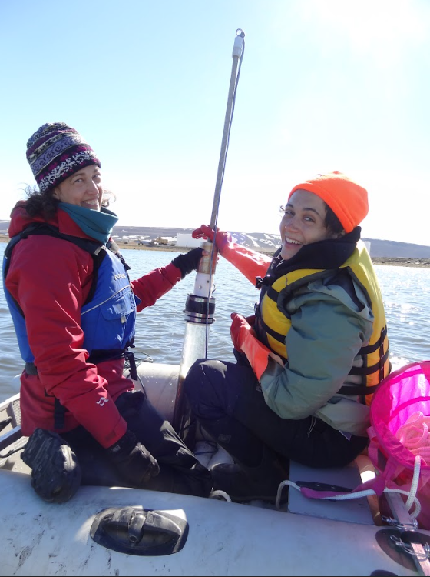
What Actually Happens?
Scientists go out on a boat and lower a special tube, called a sediment core pipe, straight down into the mud at the bottom of the lake.

Slide 4
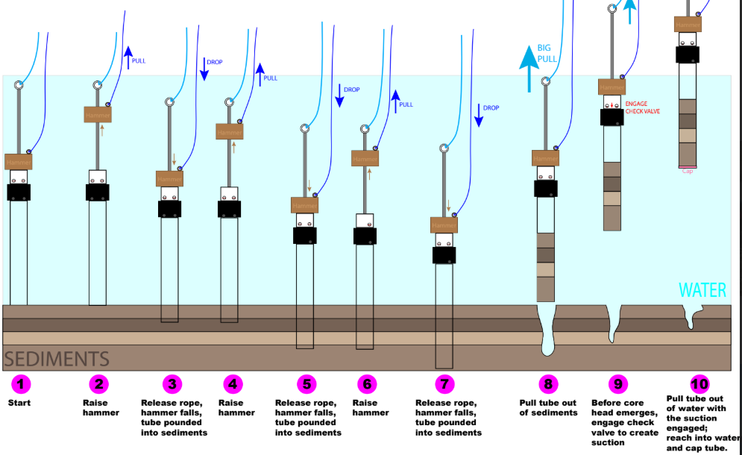
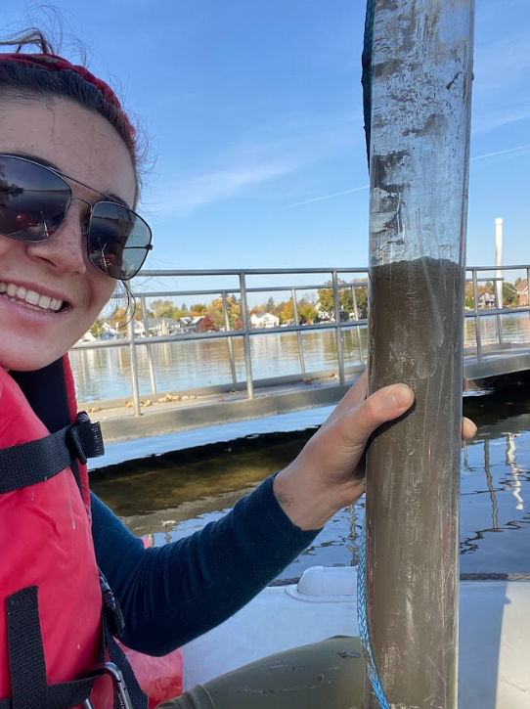
Sediment Core Piping
The tube pushes into the mud and fills up with layers of sediment (that’s the dirt, tiny rocks, pollen, and dead plants that slowly settle on the lake bottom).

Slide 5
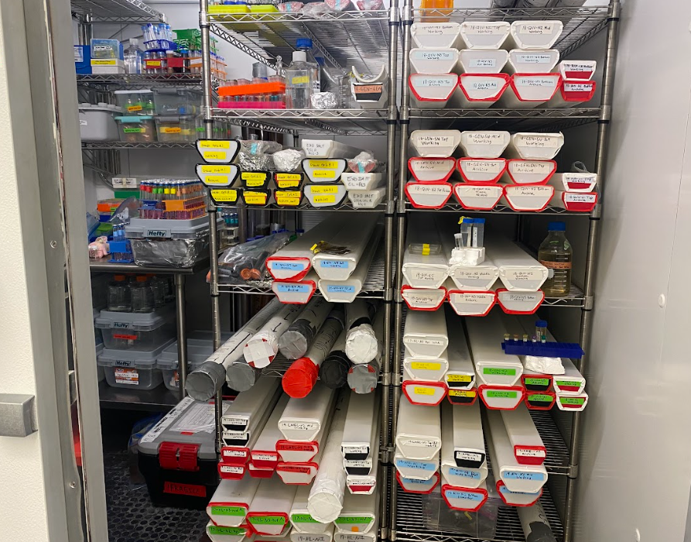
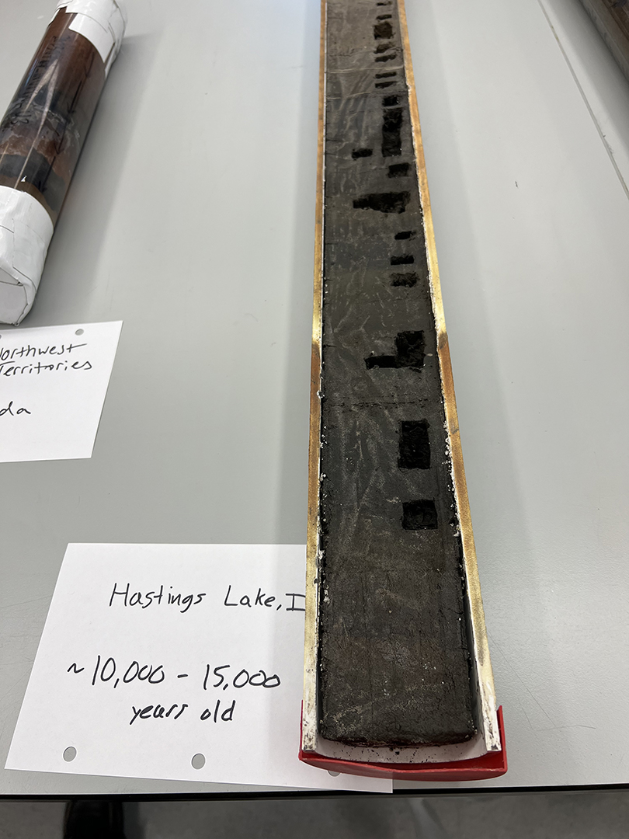
Sample Layers
When they pull the tube back up, it contains layers stacked in order, oldest at the bottom and newest at the top.

Slide 6
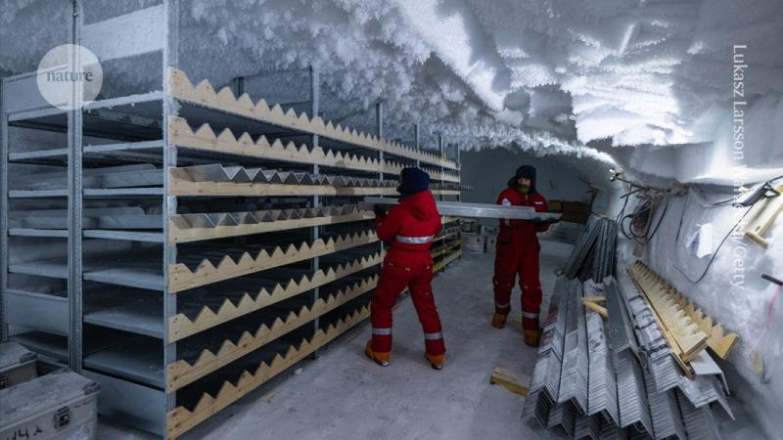
Why This is Cool
Each layer is like a page in a history book:
Pollen tells what kinds of plants used to grow nearby.
Ash can show when a volcano erupted.
Changes in color can show droughts, floods, or pollution.
Tiny fossils reveal what animals lived in the lake long ago.
Scientists study these layers to understand climate change, ecosystems, and how the environment has changed over time.

Slide 7
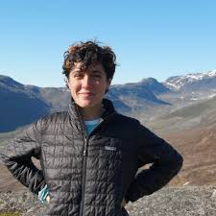
Meet Mia Tuccillo
All pictures & information in this presentation come from working with Mia!
Mia Tuccillo | Researcher Fellow
Northwestern University | Evanston, IL
Project(s):
A Paleolimnological Investigation of Climate and Nitrogen Impacts on Primary Producers in Greenland Lakes and Community Water Supplies
Mia’s research focuses on how climate and landscape changes impact ecosystems in Arctic lakes. Her project extracts chemical compounds from lake sediment archives in Kalaallit Nunaat (Greenland) to measure shifts in freshwater primary producers over the last 10,000 years. Mia’s work illuminates how climate change drives shifts in lake cyanobacteria that could pose threats to drinking water in the Arctic. She most enjoys how her research has opened doors for community conversations, research partnerships, and new friendships in Greenlandic communities.

Slide 8
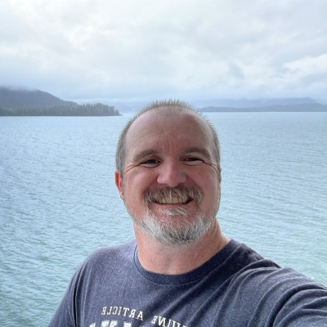
References
Bill Becker | Educator Fellow
Ronan School District #30 (Ronan Middle School) Ronan, MT
Project(s):
A Paleolimnological Investigation of Climate and Nitrogen Impacts on Primary Producers in Greenland Lakes and Community Water Supplies
Bill is a middle school math educator who creates an atmosphere where students learn through doing. He believes that it is not enough for students to learn the “how to”s of any particular subject, but rather more important that they learn the why’s and develop a comfort with solving whatever problems may arise. He strives to connect content and pedagogy to real world application to truly tap into the greatest learning potential of our youth.
Core Stories in the Anthropocene @ Northwestern
https://www.anthropocene-lab.com/core-stories-in-the-anthropocene
Northwestern students reconstruct past climate change records to model where the climate is heading today
https://planetforward.org/story/reconstructing-past-climate-change/
Mia Tuccillo | Researcher Fellow - POLAR STEAM
https://polarsteam.info/participants/mia-tuccillo-researcher-fellow/

