Slide 1
Tracking Polar Bears and Sea Ice

Slide 2
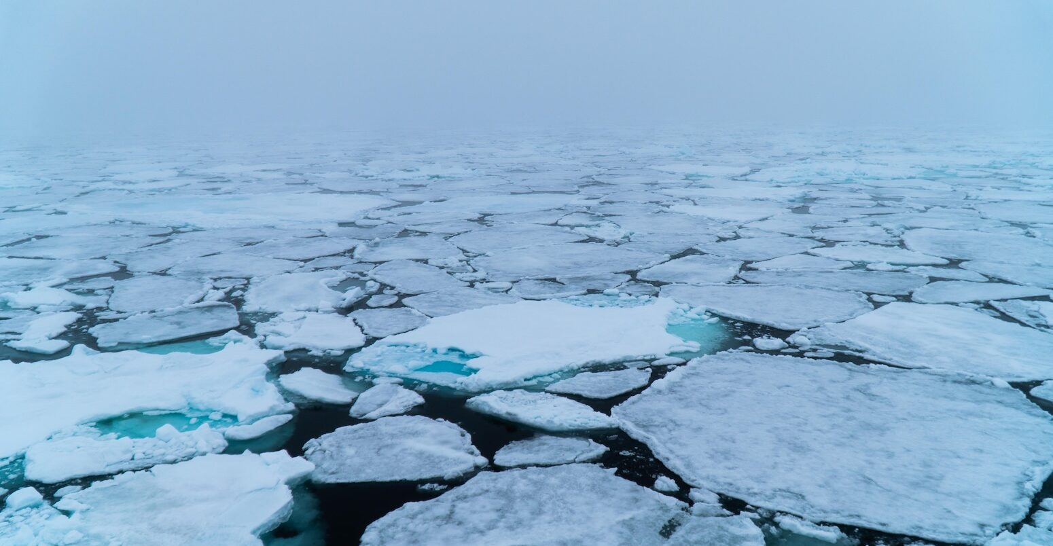
Arctic Sea Ice

Slide 3
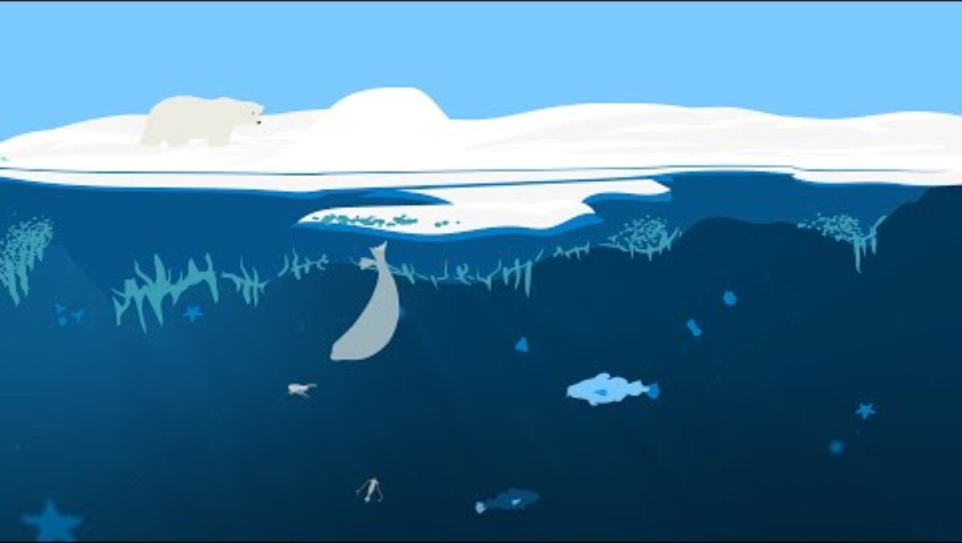
Why Does Sea Ice Matter?

Slide 4
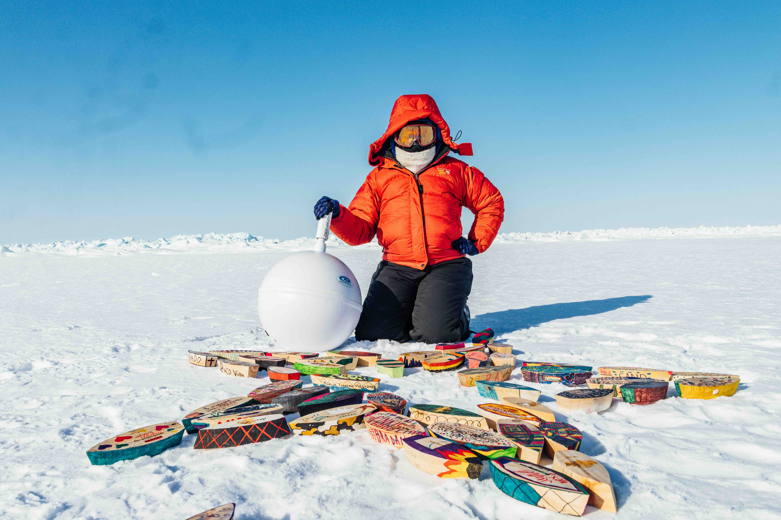
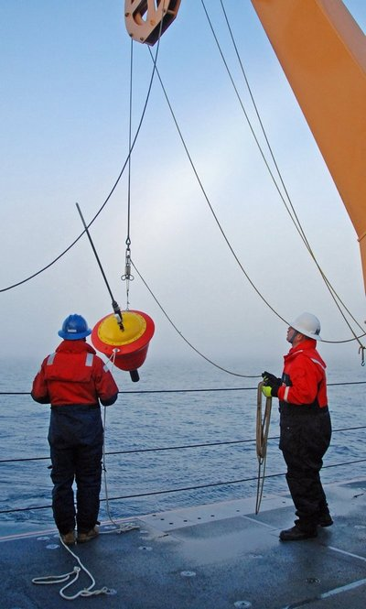
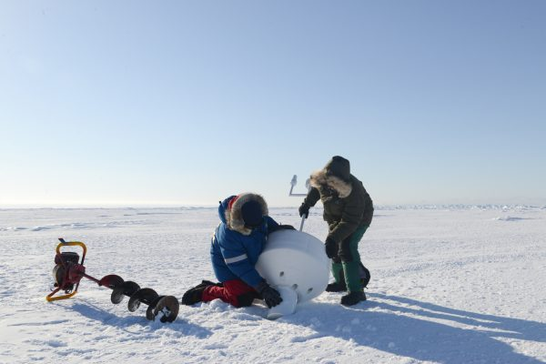
International Arctic Buoy Program (IAPB)

Slide 5
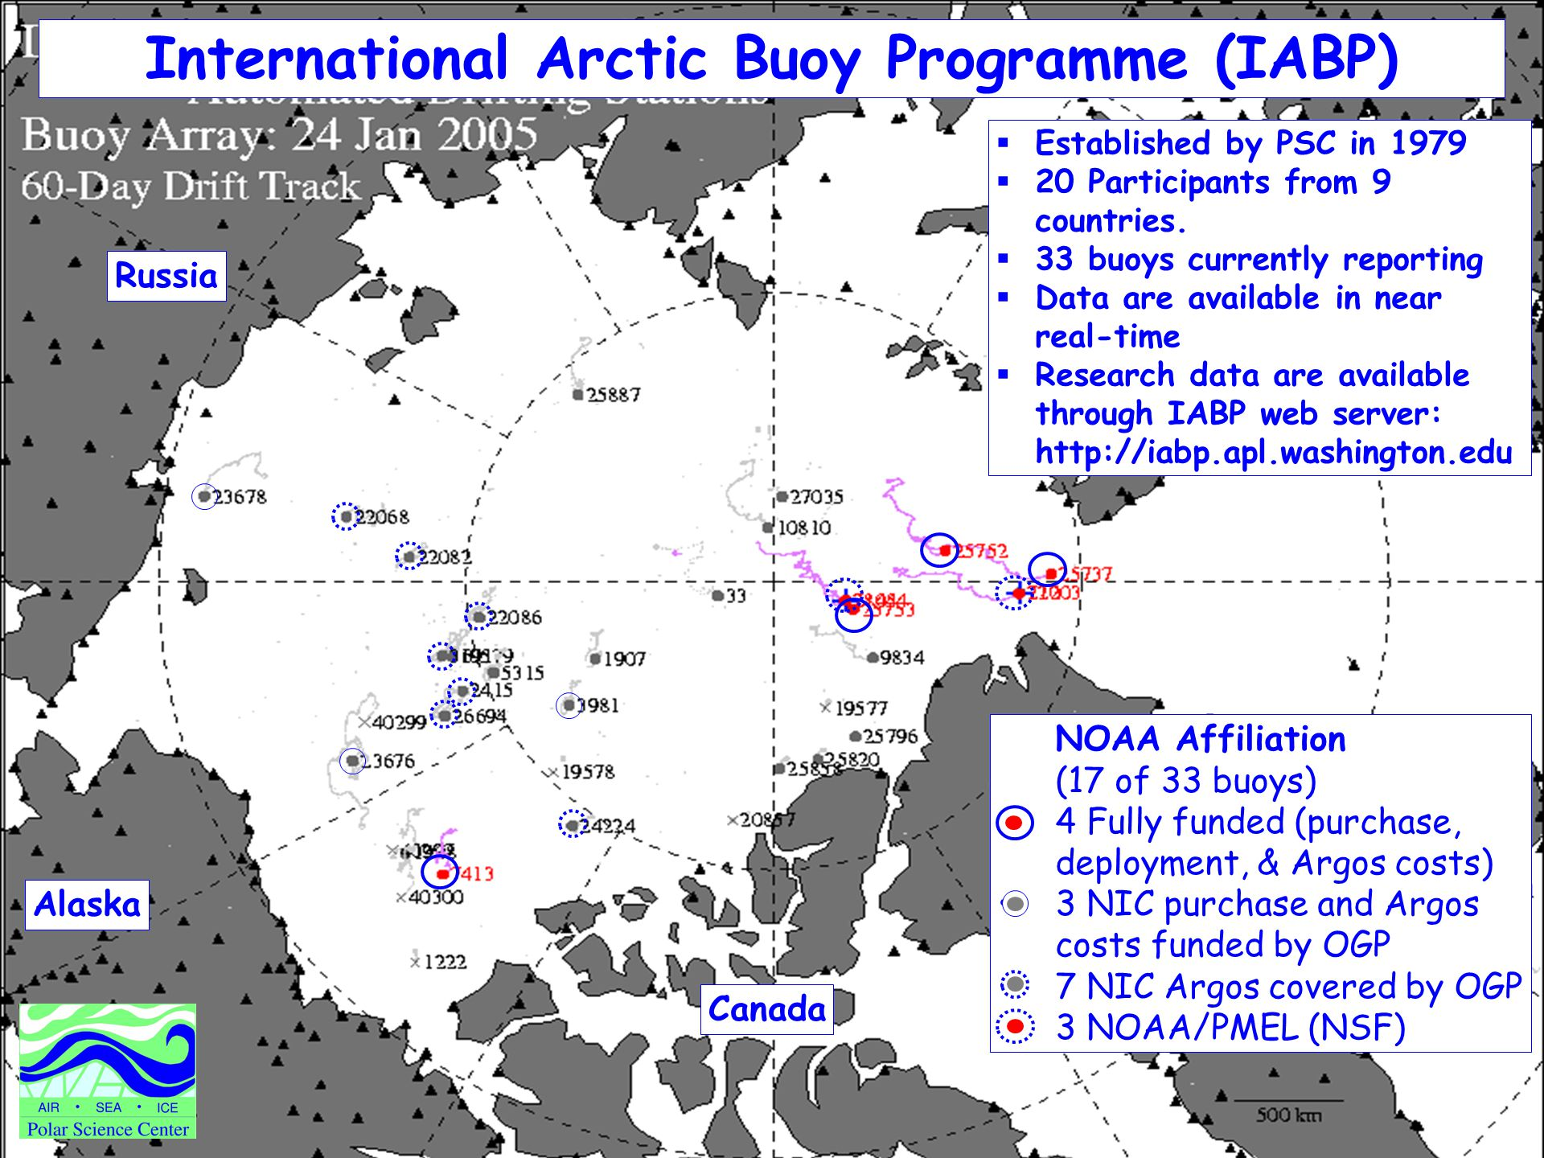
IABP

Slide 6
Stations
Tracking Ice with Remote Sensing
Polar Bear Tracking & Connection to Ice
Action & Advocacy
Engineer Your Own Buoy
Notes:
Outline instructions for each station for students, go over expectations timed rotations etc.

Slide 7
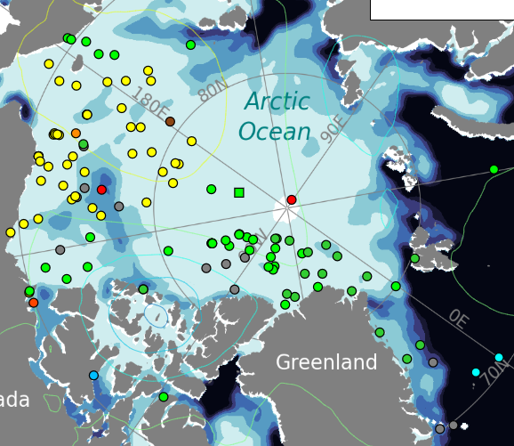
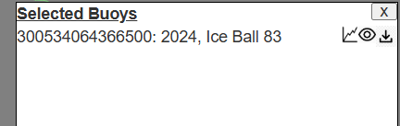
Tracking Ice with Remote Sensing
Notes:
Orient students to using the IABP map show how to select a buoy and how they will see it’s movements and data collected. Use the IABP map to locate their buoy and track its movement.
Students answer:
Where did our buoy start? Where is it now?
How fast and in what direction is it moving?
What might be influencing its path? Connect to satellite remote sensing: explain how we can “see” sea ice from space using radar and infrared sensors.

Slide 8
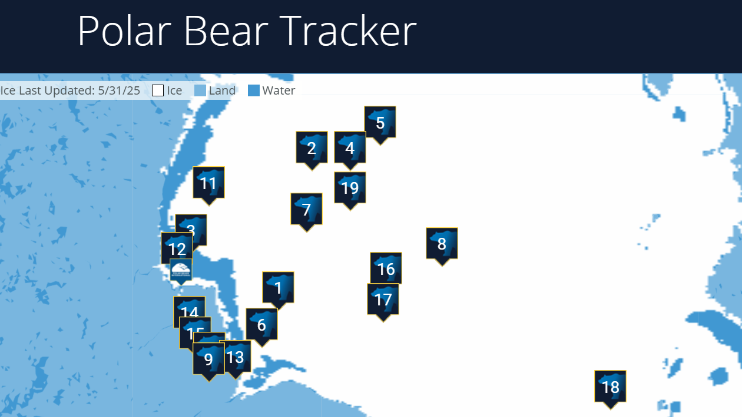
Polar Bear Tracking & Connection to Ice
Notes:
Orient students to using Polar Bears International’s polar bear tracker . Share real polar bear tracking maps from Polar Bears International
Students compare a polar bear’s movement to a nearby buoy. Are they on or near the ice? How far do they travel? What changes over time?
Discussion:
How do sea ice changes affect polar bear movement and survival?
What can polar bear tracking tell us about ecosystem health?

Slide 9
Action & Advocacy
Notes:
Give student the prompt that they will be developing a poster presentation or infographic to share what they have learned and advocate against climate change. Students create a mini-poster, infographic, or short presentation to answer:
What do buoys and bears tell us about the Arctic?
How is climate change influencing this system?
Why does this matter for people, even living far from the Arctic?
Optional Prompt for Deeper Engagement:
Imagine you're a scientist or policy advisor. What would you recommend to protect Arctic ecosystems or improve monitoring?

Slide 10
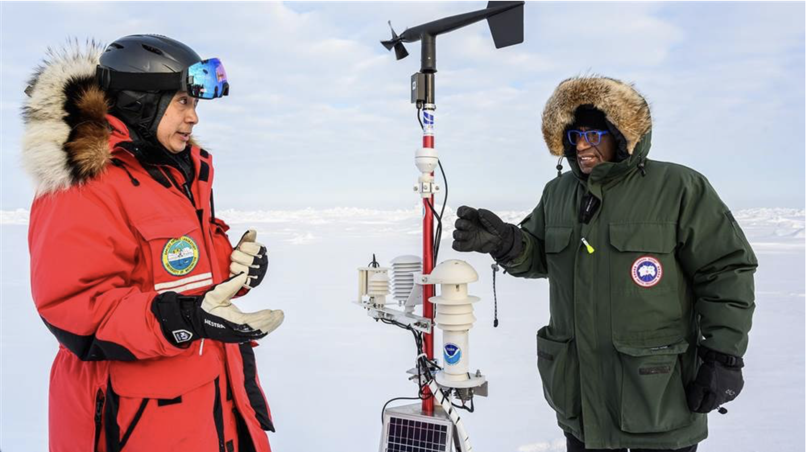
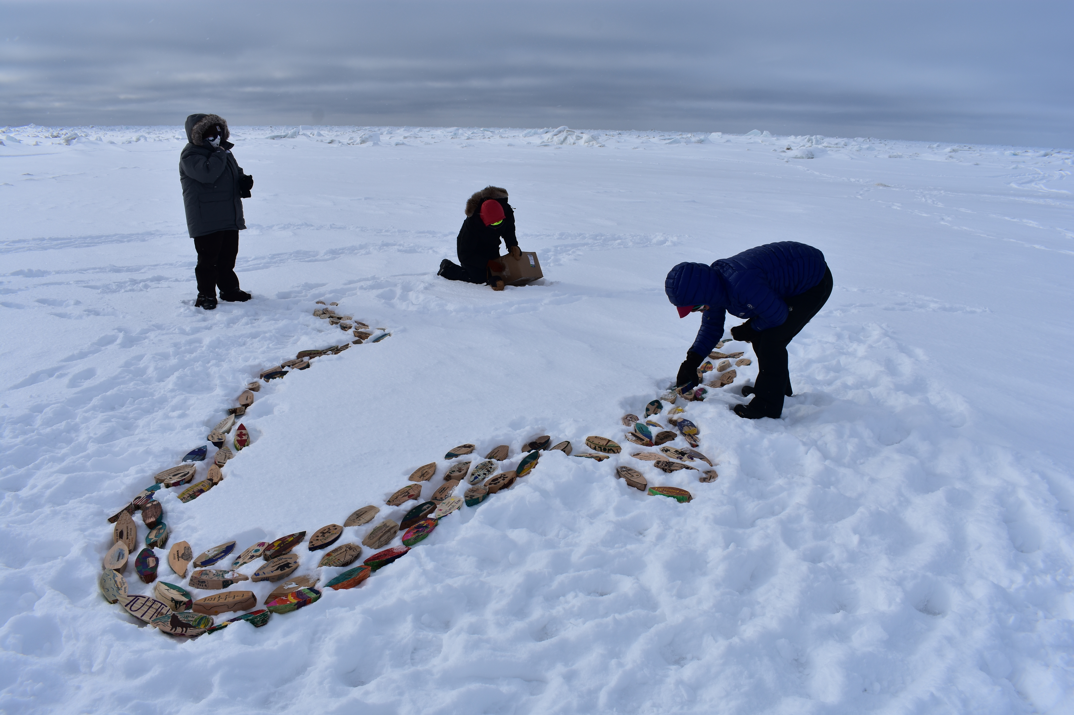
Engineer Your Own Arctic Buoy
Notes:
Give students the challenge of designing and making their own buoyDefine the problem or design challenge.
Your team is a group of Arctic Scientists tasked with building a buoy that can float in the Arctic Ocean, withstanding harsh conditions and carrying instruments to collect data.
To be successful, your buoy must achieve the following:
Float upright
Stay balanced under gentle wave action
Support a sensor
Must be able to conduct a temperature reading
Plan & Design
Students will begin by designing their buoy, keeping balance, buoyancy, and durability in mind.
Build & Test
Students build their buoys and test them in the bins of water
They can revise and retest as time allows
Can students get their buoys to remain upright through waves?
Reflect
What worked?
What didn’t work?
What design choices helped your buoy succeed?
How might this be similar to real Arctic buoys used by IABP?

Slide 11
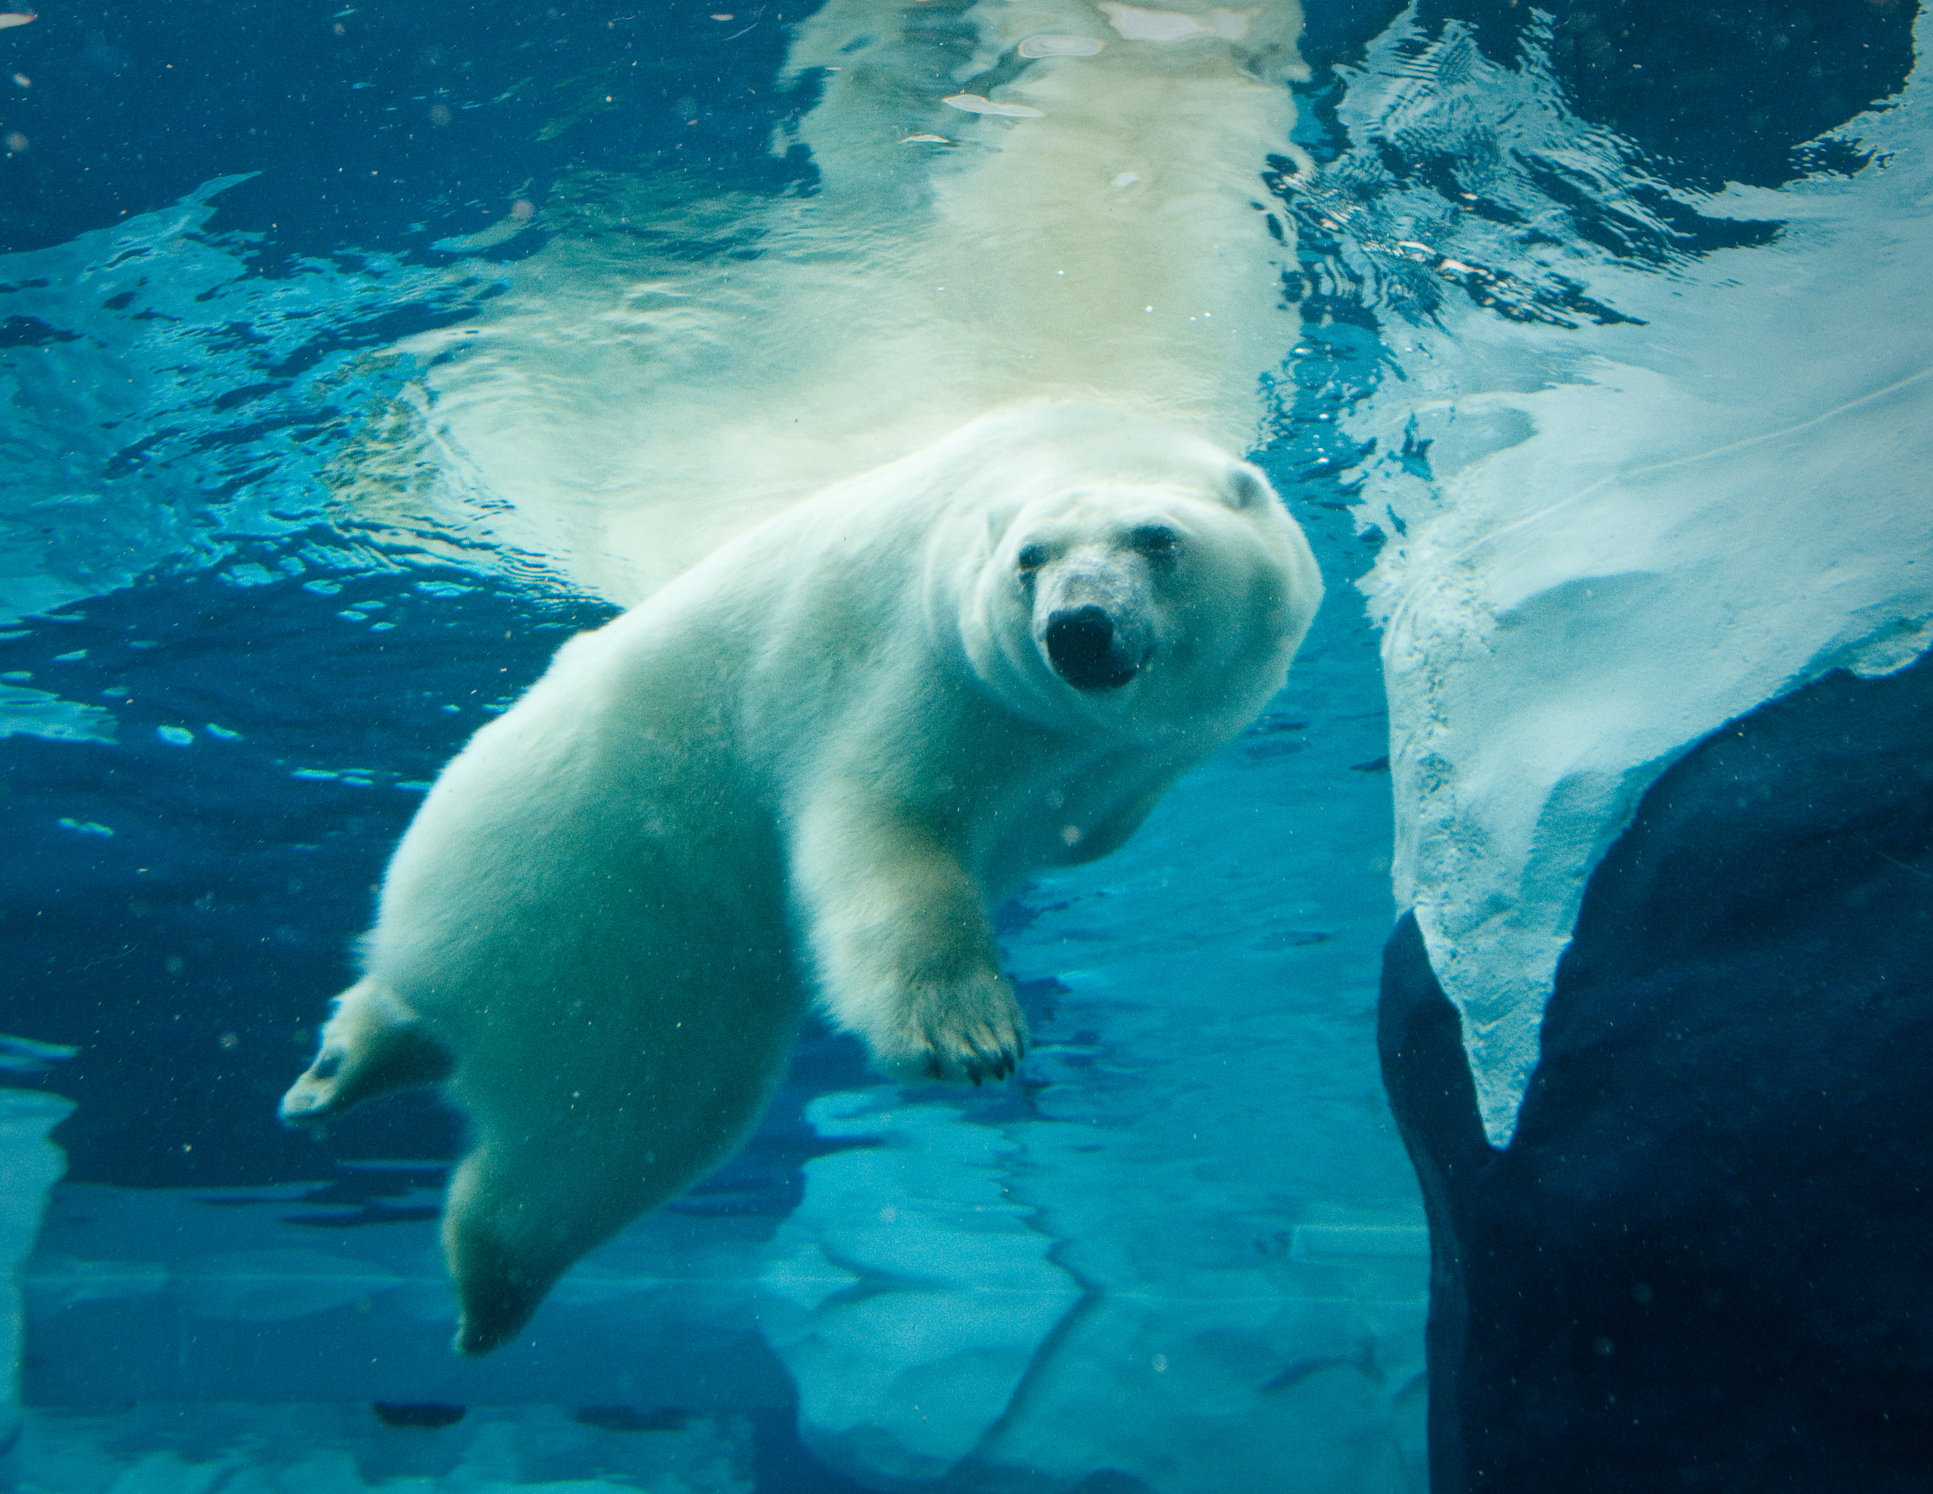
Thank You!

