Slide 1
Ice in Polar Regions
Ice is the dominant feature!

Slide 2
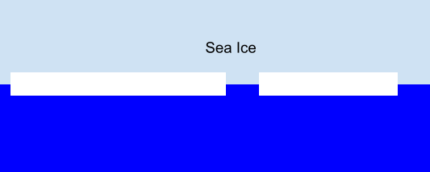
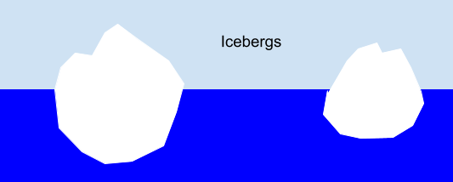
Ice in oceans
Sea Ice: water in the ocean that freezes
and floats. It is relatively thin and flat
Icebergs: chunks of ice that break off of
glaciers and ice sheets and fall into the
ocean

Slide 3
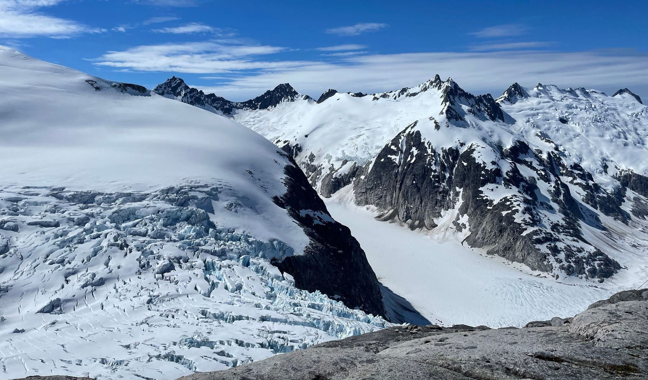
Ice on land
Glacier: large mass of ice flowing
slowly over land
Icefield: group of interconnected
glaciers covering a mountainous area
Ice sheet: huge mass of glacial ice covering an area > 50,000 km² (19,000 mi²)
Found only in Antarctica and Greenland
Permafrost: permanently frozen soil
Glacier that is part of the Juneau Icefield in Juneau, Alaska

Slide 4
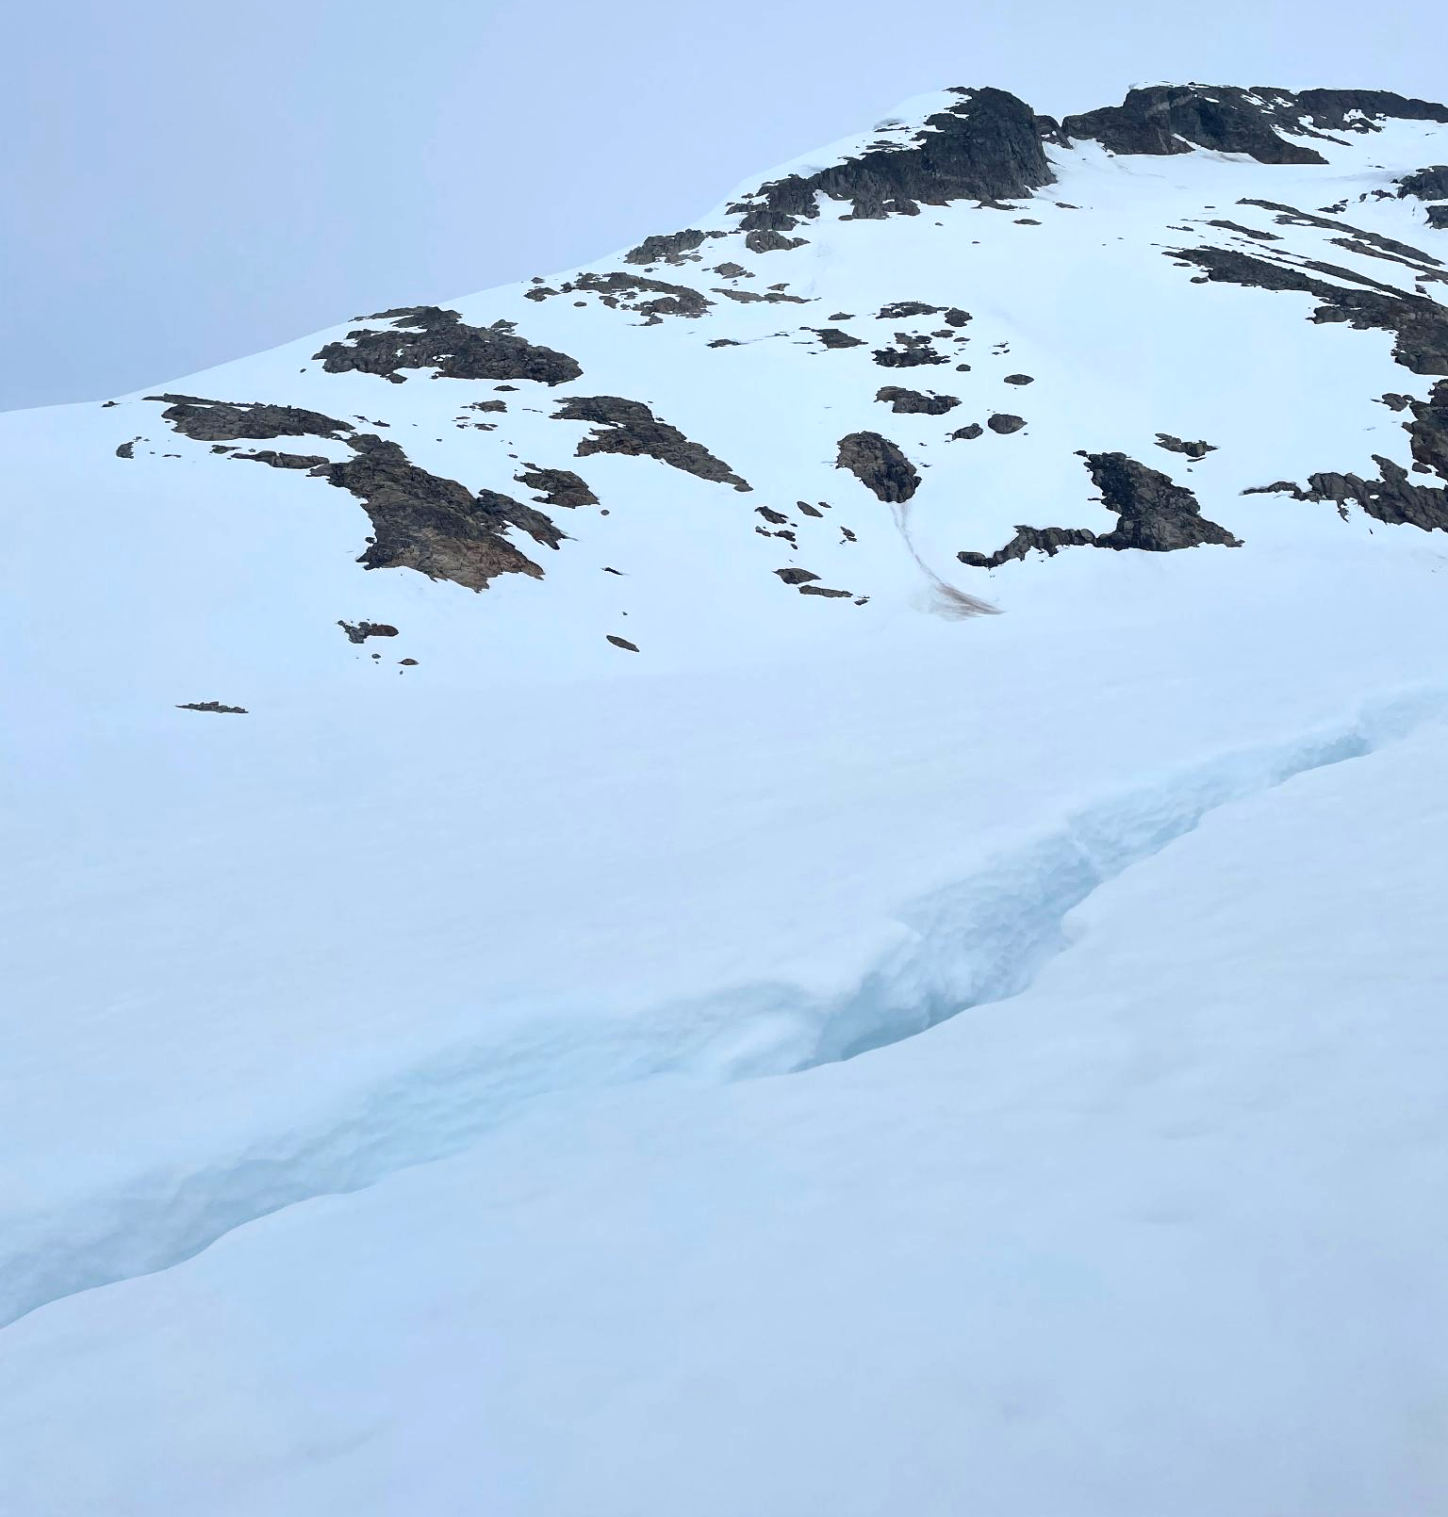
Glaciers are dynamic
Glaciers are moving and flow rates vary within and across the column of ice. This causes deep cracks in the surface to form, called crevasses
Crevasses pose a serious safety risk to mountaineers and researchers
Falling into a crevasse can cause fatal injuries or lead to hypothermia
Some are covered by a layer of snow or ice and can’t be seen before falling in
Crevasse on the Juneau Icefield in Juneau, Alaska

Slide 5
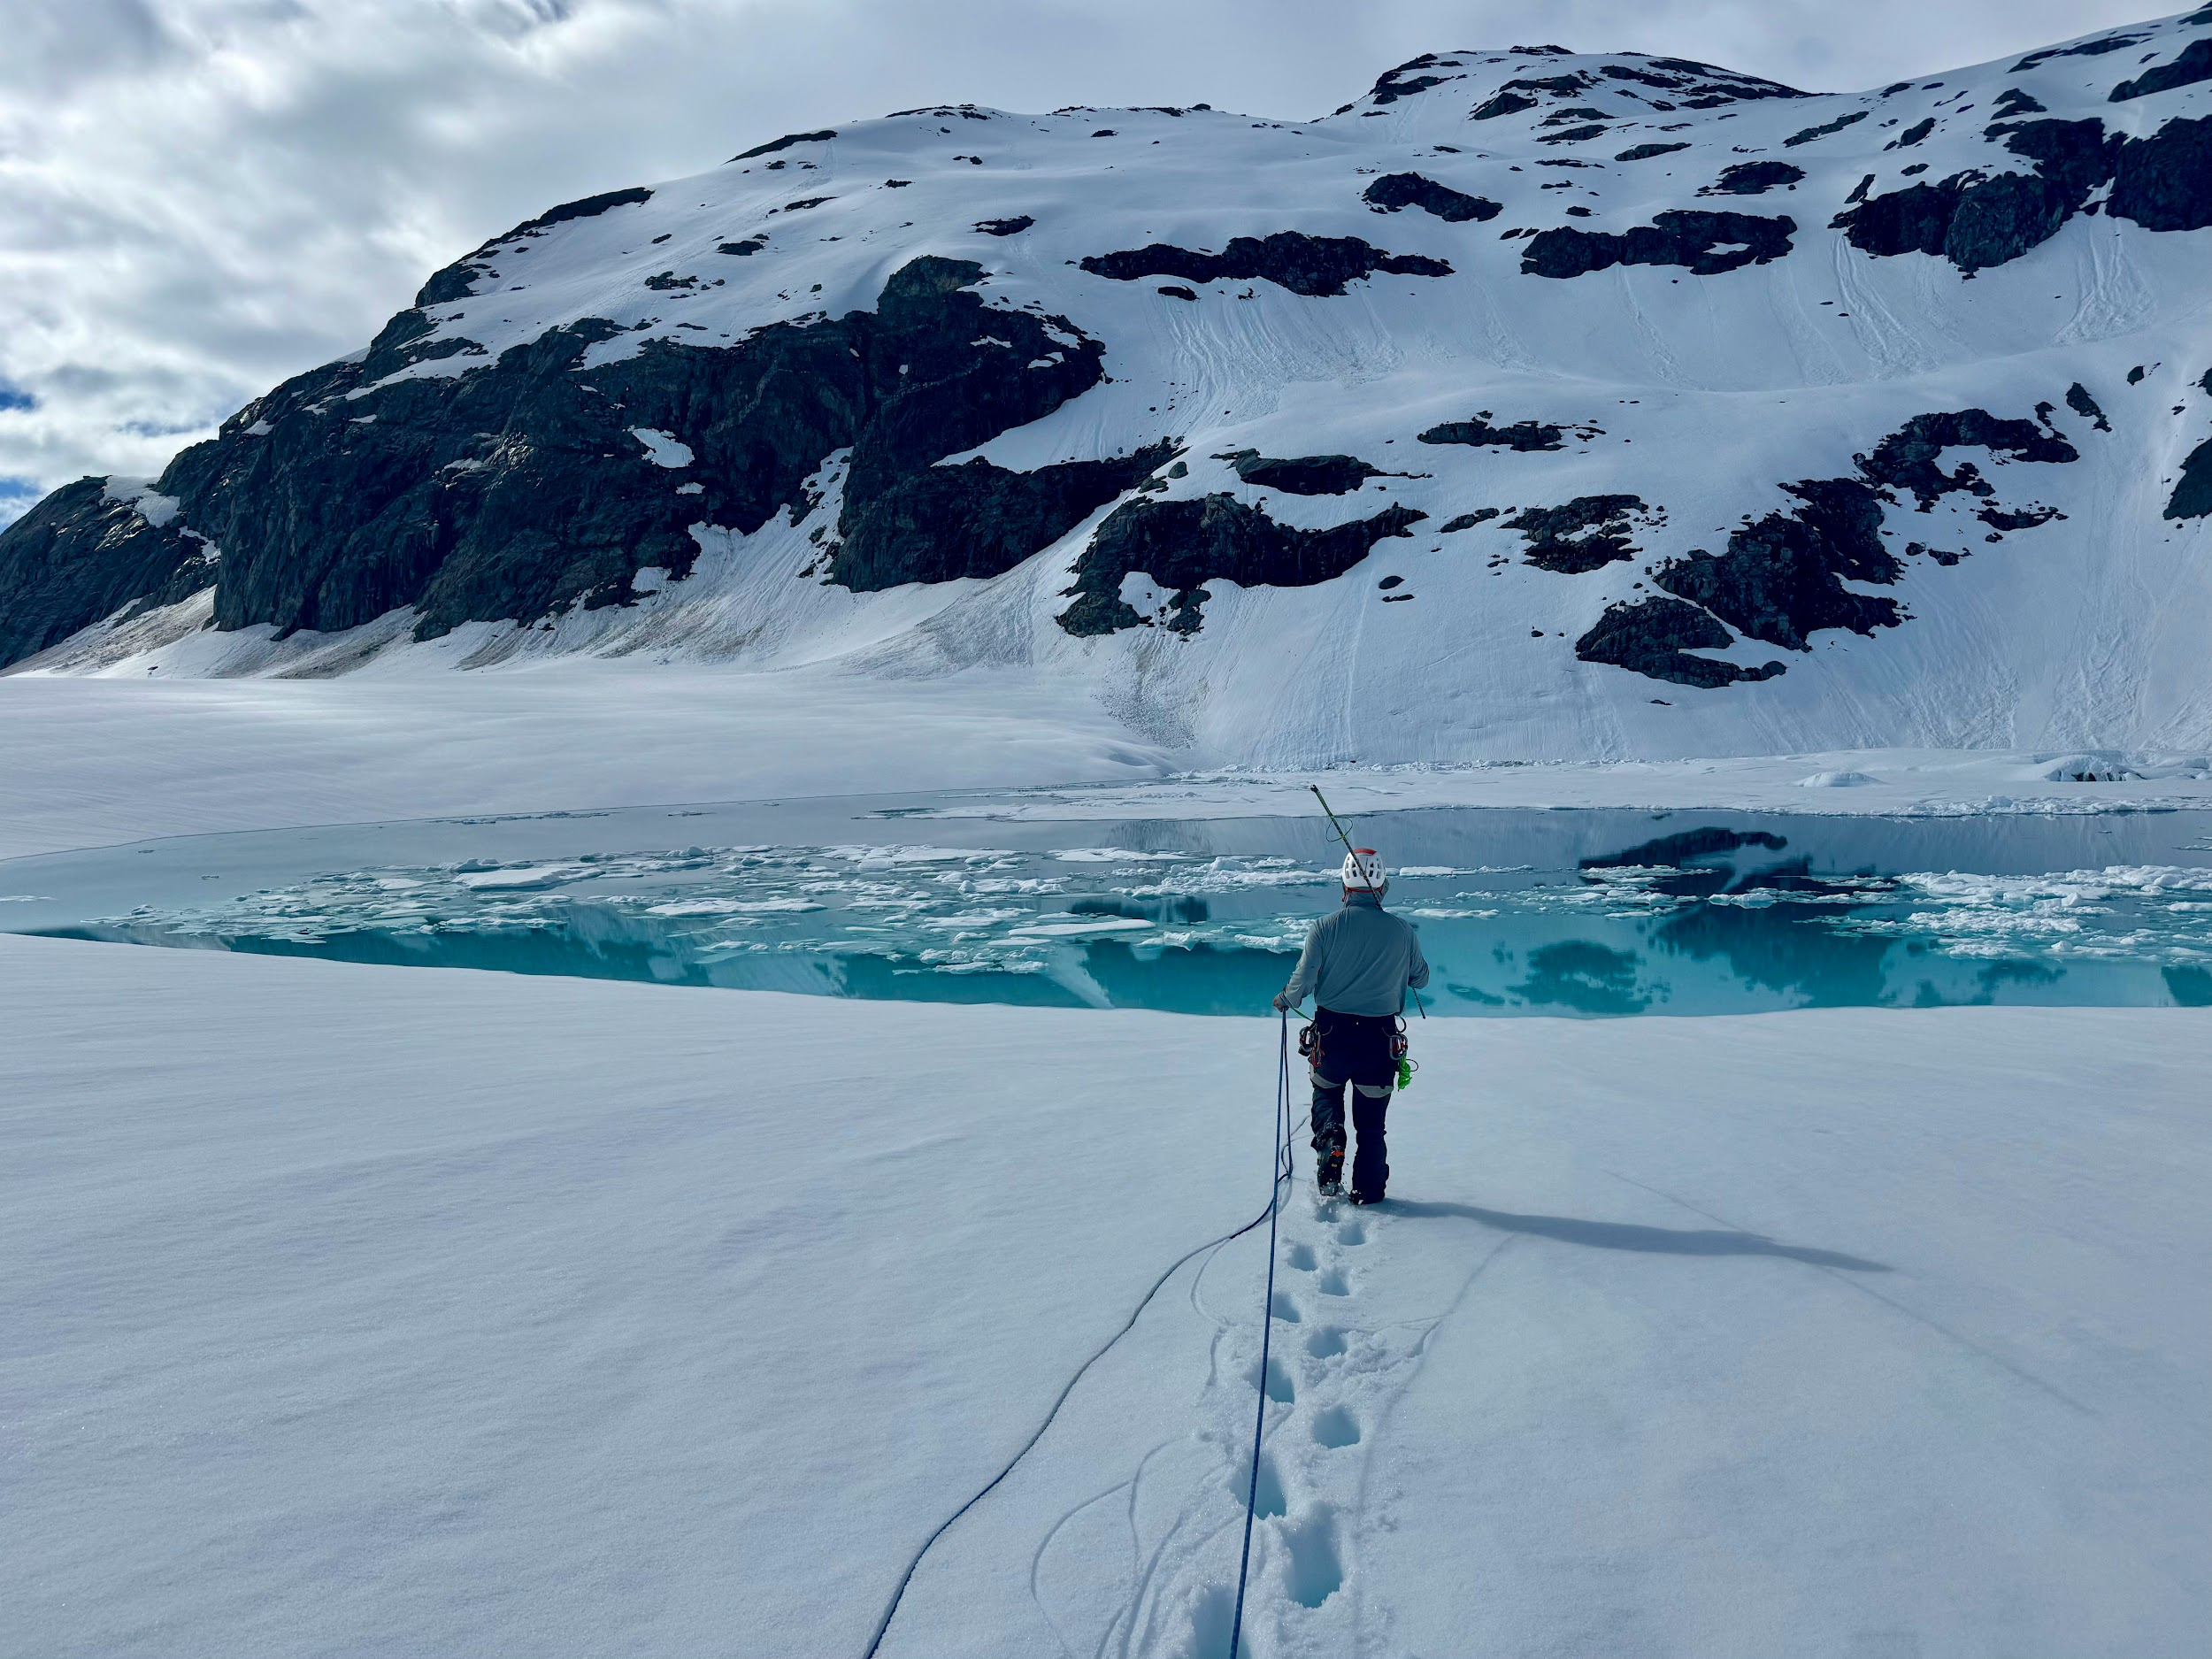
Crevasse Safety
Ropes: people are connected to each other via ropes and wear harnesses and helmets
Surface Area: wearing skis or riding a snow machine distributes weight on a larger surface area
Probes: probes are stuck into the snow to help locate hidden crevasses
Rescue training: researchers learn crevasse rescue techniques
Researcher roped for safety and carrying a probe for crevasses on the Juneau Icefield

Slide 6
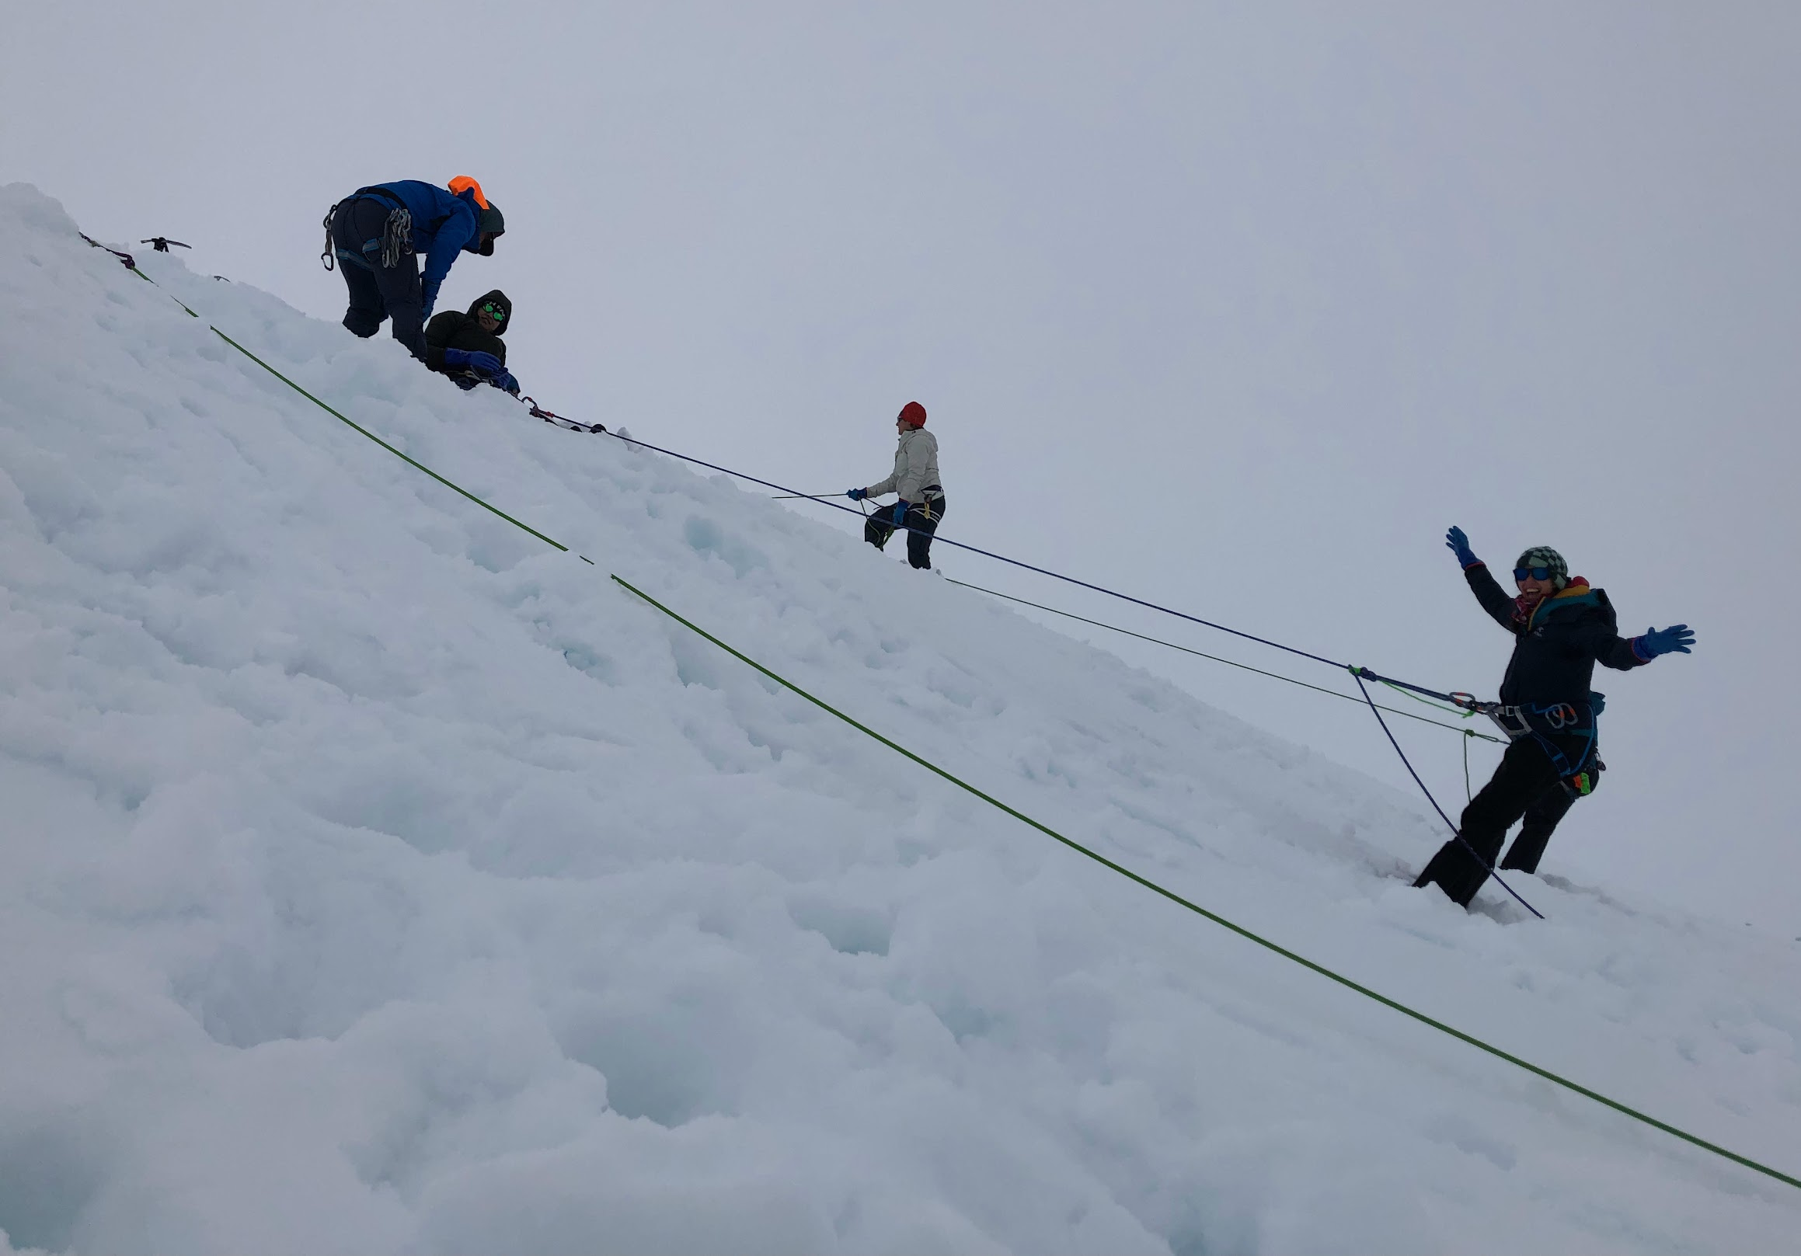
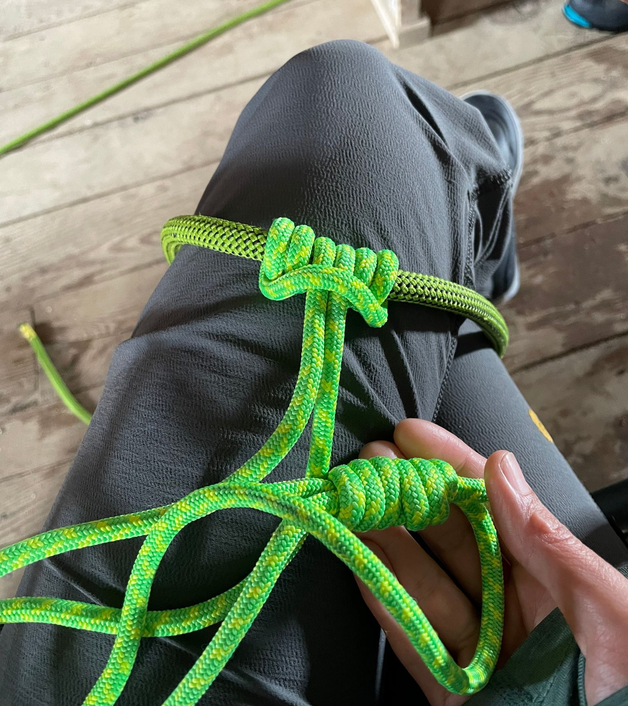
Crevasse Rescue Training
How to build anchors in the snow
Safety knots
Using mechanical advantage
Researchers participating in a crevasse rescue simulation
Learning safety knots

Slide 7
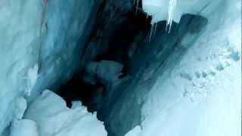
Video of Crevasse Rescue Practice
Short link: beav.es/G8V

Slide 8
Building Your Own Simple Snow Anchor
Need: a digging tool, a metal pipe, a rope, and snow (preferably on a slope)
Dig a trench in the snow length of the object, perpendicular to the load
Loop the rope around the metal pipe using a girth hitch & place it in the trench
At the bottom of the trench, in the center lengthwise, dig out a slot for the rope in the direction of pull up to the surface
Fill in the trench and slot, compacting the snow as much as possible (stomp on it!) Just don’t cover the tail of the rope!
Test the strength of your anchor by pulling on the rope. Brace yourself in case the anchor fails!
Diagrams on next slide

Slide 9
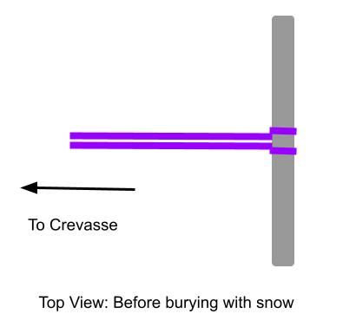
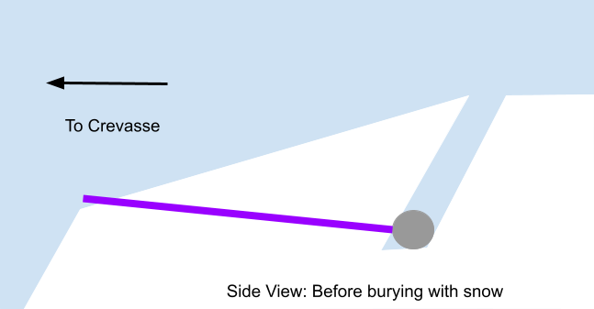
Build Your Own Simple Snow Anchor

